Slide 1


general introduction
our vision
our team
projects and collaborations
Notes:
This presentation will be a quick introduction to the ContentMine software for literature scraping, normalising, and fact extraction.

Slide 2










Open knowledge
many researchers want their work to be read and re-used by others
~80% of academic research is public-funded
we believe that charitably and publicly funded research should be available to all at no additional cost
Notes:
This presentation will be a quick introduction to the ContentMine software for literature scraping, normalising, and fact extraction.

Slide 3
The right to read is
the right to mine
The Hargreaves report (UK) allowing limitations and exceptions for non-commercial content mining research

Slide 4
our mission
“make 100,000,000 facts from the scholarly literature open, accessible and reusable”

Slide 5
the scale of the task
~ 27,000 peer reviewed journals*
> 5,000 publishers
~ 3,000 new papers per day
*Ulrich’s database: http://ulrichsweb.serialssolutions.com/login

Slide 6
structured information
chemical names and structures
species
metabolism
phylogenetic trees
Notes:
Because information is structured (some examples listed), we can aggregate similar objects and mine using a modular systematic approach.

Slide 7
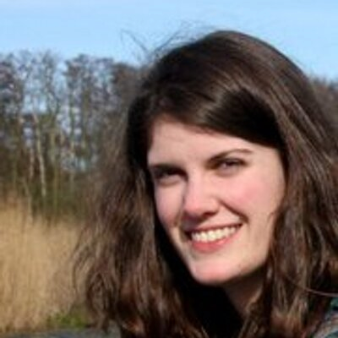


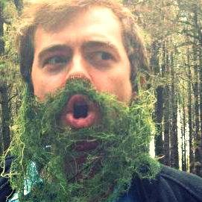
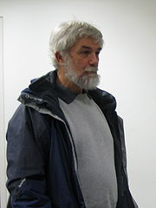

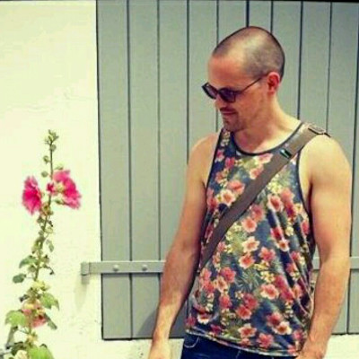
our team
Jenny Molloy
Charles Oppenheim
Graham Steel
Richard Smith-Unna
@jenny_molloy
@CharlesOppenh
@McDawg
Peter Murray-Rust
Ross Mounce
@blahah404
Mark MacGillivray
Stephanie Smith-Unna
@rmounce
@cottagelabs
@treblesteph
@petermurrayrust
Notes:
Because information is structured (some examples listed), we can aggregate similar objects and mine using a modular systematic approach.

Slide 8
collaborations
Mint phylogeny working group
Phyloinformatic Literature Unlocking Tools (PLUTo)
EBI - MetaboLights
OpenFarm
OpenOil / OpenCorporates
Notes:
Can describe each collaboration, but keep this slide brief if the presentation is short.

Slide 9
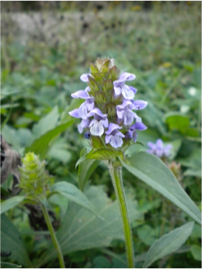

mint phylogeny working group
Sixth largest family of flowering plants
Major economic and cultural importance
Studying coevolution of their chemical compounds and genomes
We are helping to extract these phytochemicals using AMI-species
Bryan Drew, Douglas Soltis, Pamela Soltis
http://lamiaceae.myspecies.info/content/lamiaceae
Notes:
Can describe each collaboration, but keep this slide brief if the presentation is short.

Slide 10
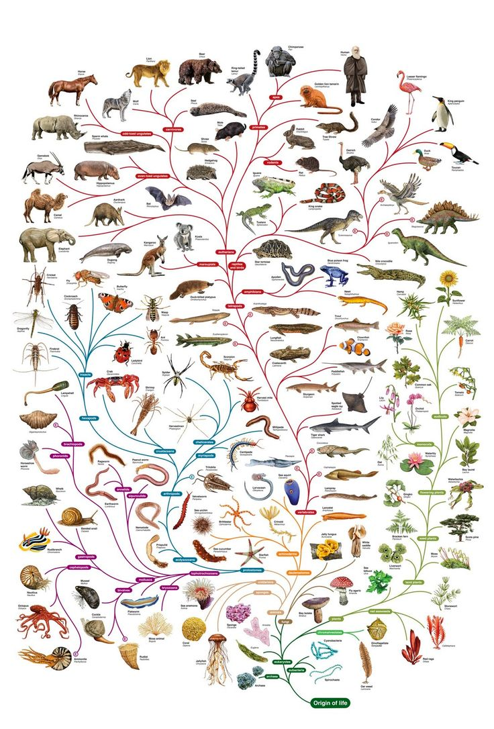
pLuto
Phyloinformatic Literature Unlocking Tools (PLUTo)
Phylogenetic information is scattered across >100,000 papers
Hard to synthesise manually
PDF >> extract phylogenetic trees >> reusable data in standardised format (Newick trees)
http://www.open.ac.uk/science/main/schools/tree-life-resources
Notes:
Can describe each collaboration, but keep this slide brief if the presentation is short.

Slide 11

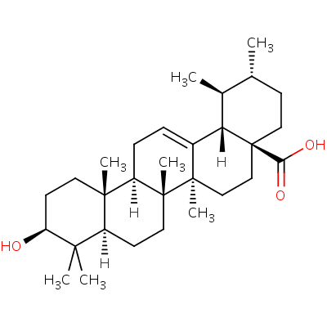

Metabolights
European Bioinformatics Institute
database for metabolomics experiments and derived information
cross-species, cross-technique, structures, biological roles, locations, concentrations
http://www.ebi.ac.uk/metabolights/
Notes:
Can describe each collaboration, but keep this slide brief if the presentation is short.

Slide 12

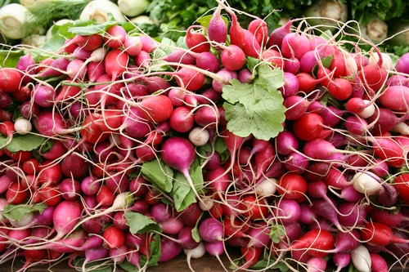
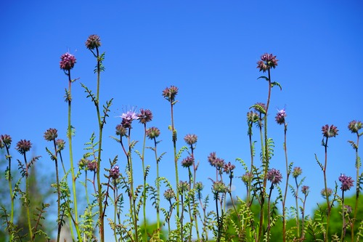
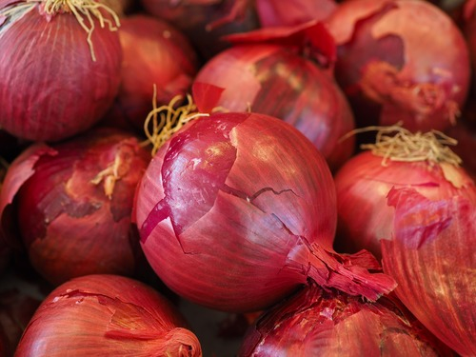
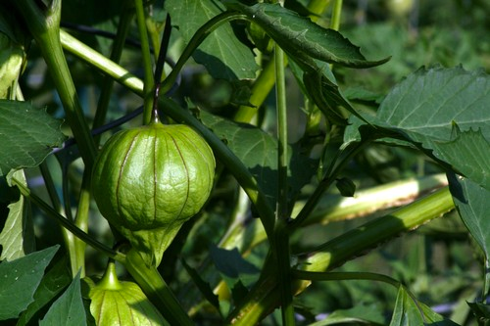
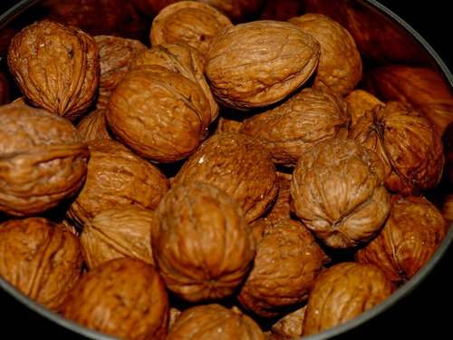
Openfarm
community-driven open knowledge base of plant information related to agriculture and horticulture
we provide technical and social infrastructure for high throughput fact extraction
https://openfarm.cc/
Notes:
Can describe each collaboration, but keep this slide brief if the presentation is short.

Slide 13
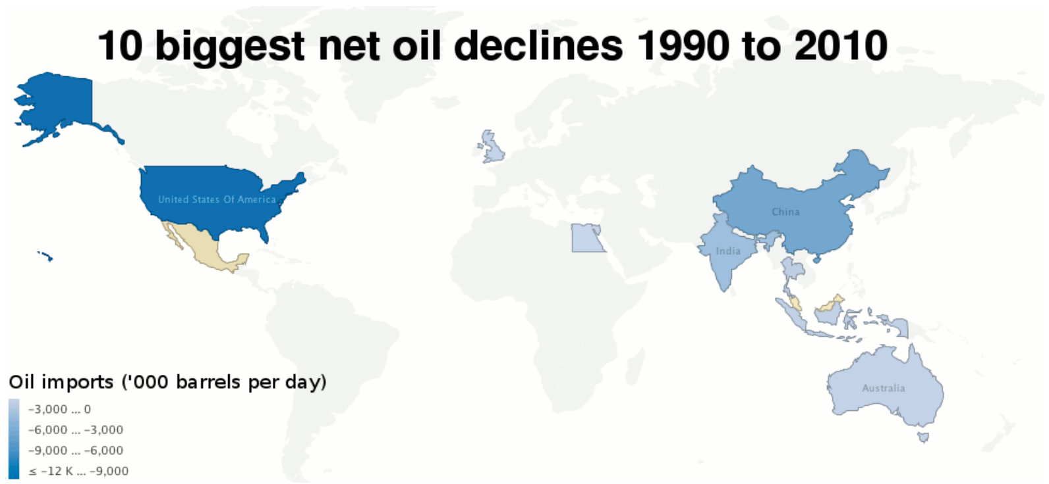

openoil / opencorporates
creative, practical, socially progressive policy-making
corporate network mapping
we provide the crawl/scrape/normalise/extract pipeline
http://openoil.net/
Notes:
Can describe each collaboration, but keep this slide brief if the presentation is short.

